Slide 1


Eukaryotic and prokaryotic DNA TYPE
Lecture 5
Dr. Rawa Abdul Redha Aziz
Ph.D Antibiotics/ Molecular biology

Slide 2
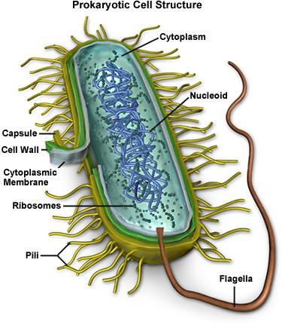
Prokaryotic DNA
The nucleoid (meaning nucleus like) is an irregularly- shaped region within the cell of a prokaryote that contains most of the genetic material. In contrast to the nucleus of a eukaryotic cell it is not surrounded by a nuclear membrane.
The genome of prokaryotic organisms generally is a called circular double stranded piece of DNA of which multiple copies may exist at any time.
The length of a genome widely varies but generally is at least a few million base pairs.

Slide 3
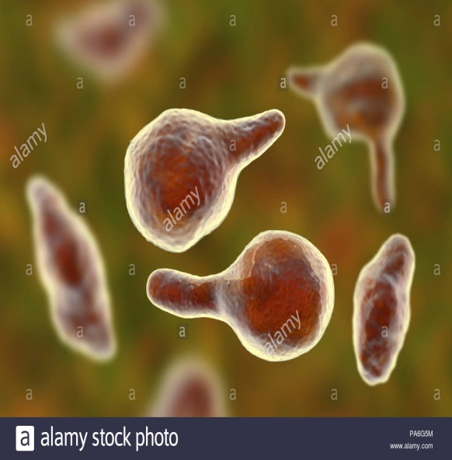
Haploid chromosome occupied the half of the cel
A genophore is the DNA of a prokaryote circular in most prokaryotes, and linear in very few of them; it is usually called prokaryotic chromosome.
A genophore can be as small as 580.073 bp (as in Mycoplasma genitalium) while the largest genophore of E. coli about 10.000 Kbp with 4000 genes. Many eukaryotes (such as plants and animals) carry genophores in organelles such as mitochondria and chloroplast.
The term chromany prokaryotic organism employs some specialized protein (that can be considered as histone- like protein).

Slide 4
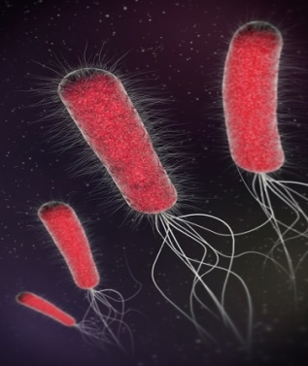
Chromosome of E. coli
It is circular and this is a common arrangement, but there are a number of species with linear chromosomes.
If stretched out, this material would be about 1400 µm long or about 1/16th inch.
The E. coli cell is about 1-5 µm in length, so it is clear that an amazing degree of packing is necessary to fit the chromosome inside its tiny host.
The nucleoid occupies about half of bacterial cytoplasm and has a density of 20-50 mg/ml, similar to what is observed for the nucleus of a non-dividing eukaryotic cell

Slide 5
The genetic material here is composed from 60% protein a large amount of RNA polymerase and mRNA, rRNA, transcription factor proteins that regulate the expression of genes. These seem not to perform any structural role, but reflect the importance of RNA transcription in the nucleoid in growing cells.
The nucleoid is composed of DNA in association with a number of DNA- binding proteins (histone like protein) that help it maintain its structure specially H1 (MW 16000D) that plays role in packaging forming condense protein core (Scaffold) and these protein are rich with basic amino acid Arginine and lysine (with additional NH3 group).

Slide 6
Nucleoid- Associated Proteins (NAPs)
Proteinsor nucleoid proteins or nucleoid- associated proteins (NAPs) are distinct from histones of eukaryotic nuclei. In contrast to histones, the DNA binding proteins of the nucleoid do not form nucleosome, in which DNA is wrapped around a protein core. Instead, these proteins often use other mechanisms to promote compaction such as DNA looping. The most studied NAPs are HU, H-NS, FIS, IHF and SMC that organize the genome by driving events such as DNA bending, bridging, and aggregation.

Slide 7
H-NS: histone-like nucleoid structuring ( It binds to DNA non- specifically and is apparently involved in compacting DNA structure)
HU: heat unstable protein (non- specifically binds to DNA)
FIS: Factor for inversion stimulation
IHF: Integration host factor (facilitates bending of DNA, but it does so by binding to specific DNA sites)
These proteins can form clusters (like H-NS dose) in order to locally compact specific genome regions, or be scattered throughout the chromosome (HU, Fis) and they seem to be involved also in coordinating transcription events, spatially sequencing specific genes and participating in their regulation.

Slide 8
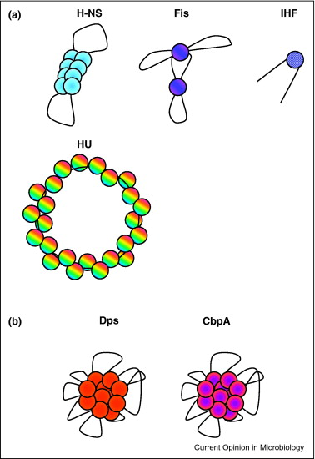
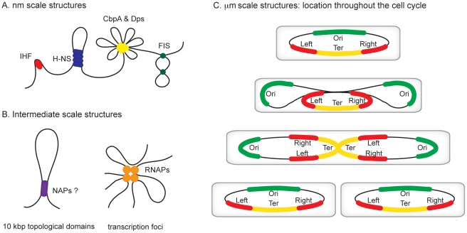

Slide 9
Structural bacterial chromosome
The chromosome is further folded into 50 or 100 loops (domains) supercoiled independent and indeed, even small sections within the same loop can transiently have different degrees of supercoiling, the specific supercoiling of a region can affect the ability of the cell to express genes in that region.
Because supercoiling is affected by so many things and in turn can affect expression of much of the genome, it will be important for microbiologists to develop a better understanding of this phenomenon in the future.

Slide 10
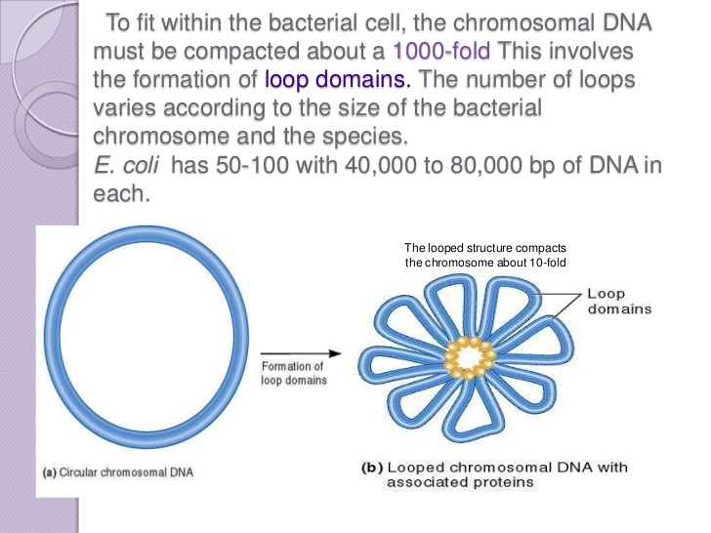
Chromosome structural organization:
The unfolded, circular chromosome of E. coli depicted as a single line for simplicity, though of course it is a double stranded helix.
The DNA folded into chromosomal domains by protein-DNA associations.
Supercoiling and other interactions cause the chromosome to compact greatly.

Slide 11
Eukaryotic DNA
Chromatin organization and chromosome structure
Chromosome: components in a cell that contain genetic information. Each chromosome contains numerous genes. Chromosomes occur in pairs: one obtained from the mother; the other from the father.
Gene: the fundamental physical and functional unit of heredity. A gene is an ordered sequence of nucleotides located in a particular position on a particular chromosome that encodes a specific functional product (i.e, a protein or RNA molecule).
DNA: the material inside the nucleus of cells that carries genetic information. The scientific name for DNA is deoxyribonucleic acid.

Slide 12
Basic Structure of Chromosome
What is a chromosome?
Chromosomes are thread like structures located inside the nucleuc of animal and plant cells. Each chromosome is made of protein and a single molecule of DNA.
The term chromosome comes from Greek words for color (chroma) and body (soma). The unique structure of chromosomes keeps DNA tightly wrapped around spool-like proteins, called histones. Without such packaging, DNA molecules would be too long to fit inside the cell. For example, if all of the DNA molecules in a single human cell were unwound from their histones and placed end-to-end, they would stretch 6 feet the condensed nucleoprotein structure is called chromatin

Slide 13
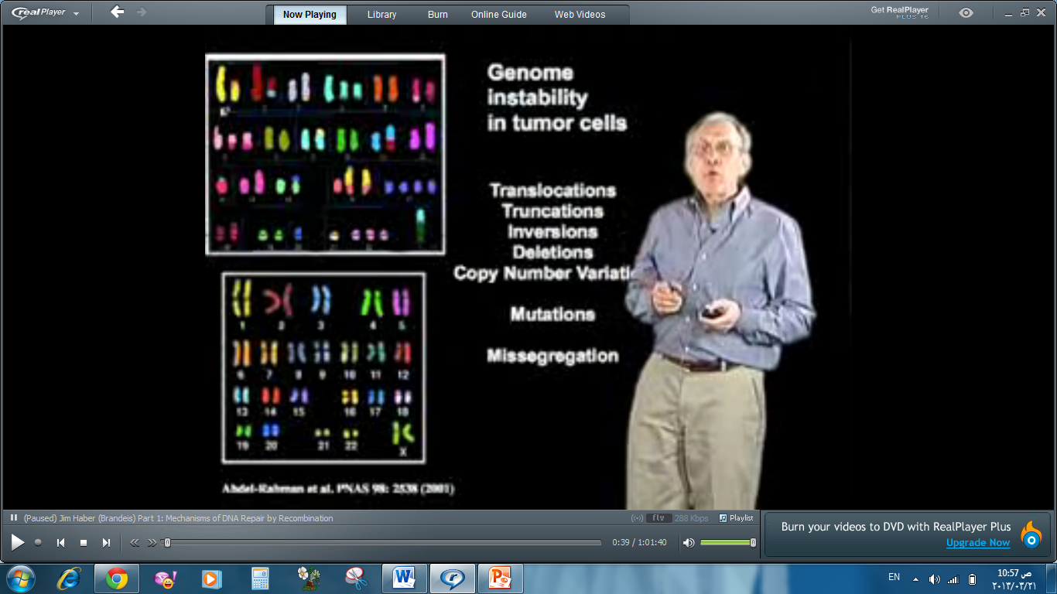
How many chromosomes do humans have?
Humans have 23pairs of chromosomes, for a total of 46chromosomes. In fact, each species of plants and animals has a set number of chromosomes. A fruit fly, for example, has four pairs of chromosomes, while a rice plant has 12 and a dog, 39.

Slide 14
Basic information about chromatin
Nuclear DNA does not appear in free linear strands; it is highly condensed and wrapped around histones in order to fit inside the nucleus and take part in the formation of chromosomes.
Chromatin is the major component of the nucleus, the genetic material consist from 50% DNA and protein for each and during interphase this chromatin appeared as uncondensed diffused material look like beads- in string but during metaphase it will arrange to thread like structure. The beads are called nucleosomes.
Each nucleosome is made of DNA (~147bp of DNA) wrapped around eight histone proteins that function like a spool is called histone octamer.

Slide 15
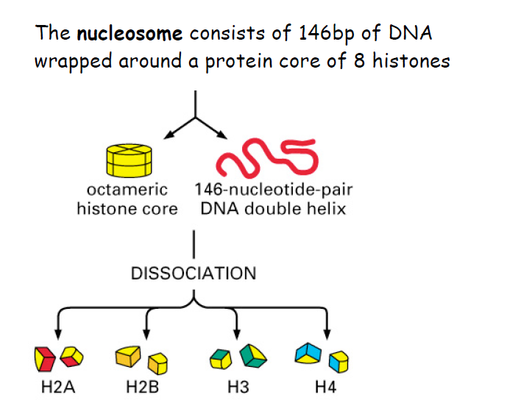

Slide 16
Histones are a family of basic proteins that associate DNA in the nucleus and help condense it into chromatin. Their positive charge allows them to associate with DNA, which is negatively charged. Some histones function as spools for the thread-like DNA to wrap around. Each histone octamer is composed of two copies each of the histone proteins H2A, H2B, H3, and H4. They are all found in equal parts in the cell and their amino acid sequences contain between 20 and 25% of lysine and arginine
Each nucleosome attached with followed one by linker DNA (20-60bp) thus total DNA wrap around it =200bp which will be protected from digestion with micrococcal endonuclease (Cutting enzymes!!)

Slide 17
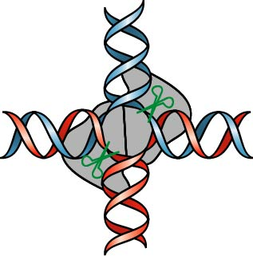

Slide 18
The linker histones are H1 and H5
Inside the core there are the octameric protein while the fifth histoneH1 usually exist outside the core (in the binding region between nucleosome and another) and it will bind and protect 20bp of DNA while the rest of the remaining 200-240bp represent the linker. The length of the nucleosome is 5.5nm and the diameter is 10-11nm.
Primary experiment to understand nucleosome structure (as it is nucleoprotein material) carried out by Kornberg (1977) when he treated DNA with Micrococcal endonuclease (Micrococcus spp). The result revealed that DNA will be cleaved in the linker region releasing free nucleosome that contains 170-240bp of DNA.

Slide 19
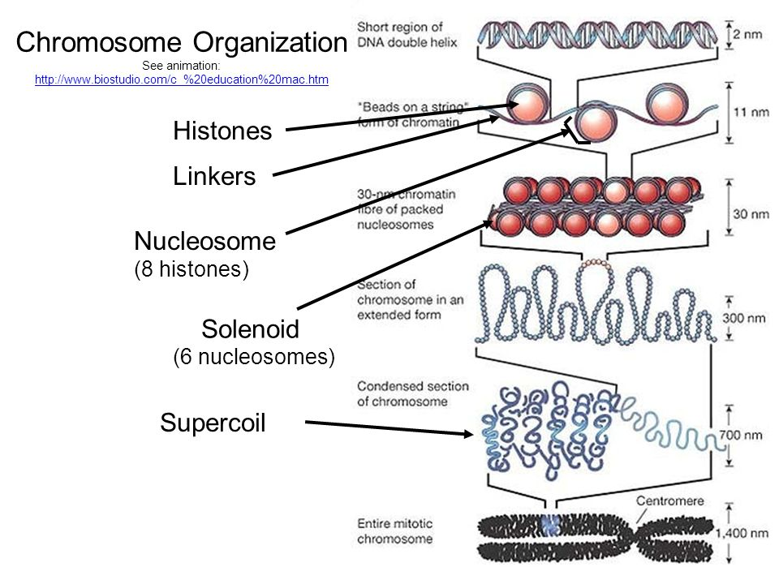
More extensive treatment results in digestion of all but not the 146-147bp DNA that wrap the octameric or nucleosome core protein complex, thus the length of linker DNA differ from one tissue to another.
The chain of nucleosomes is then wrapped into a 30 nm spiral called a solenoid.

Slide 20
Higher – order structures include the 30nm fiber (the irregular zigzag form) and 100nm fiber, these are structures found in normal cells. In mitosis and meiosis, the condensed chromosomes are assembled through interaction between nucleosome and other regulatory proteins. In general, genes that are active have less bound histone; while inactive genes are highly associated with histones during interphase.
Without histones, the unwound DNA in Chromosomes would be very long (A length to width ratio of more than 10 million to 1 in human DNA). For example, each human cell has about 1.8 meters of DNA, but wound on the histones it has about 90 micrometers (0.09mm) of chromatin, which, when duplicated and condensed during mitosis, result in about 120 micrometers of chromosomes.

Slide 21
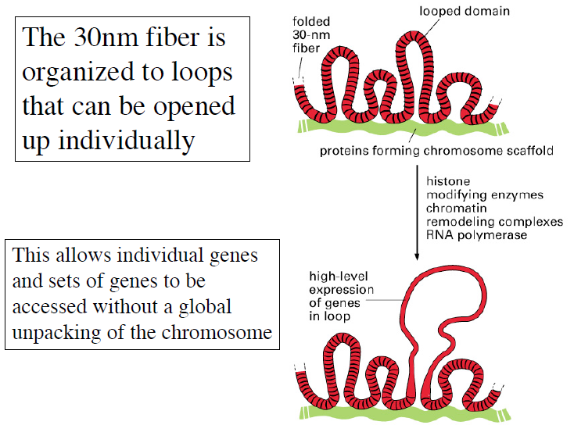

Slide 22
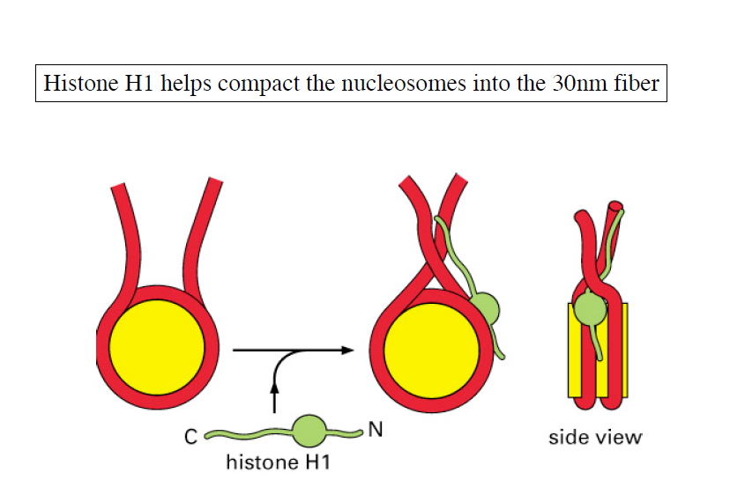

Slide 24
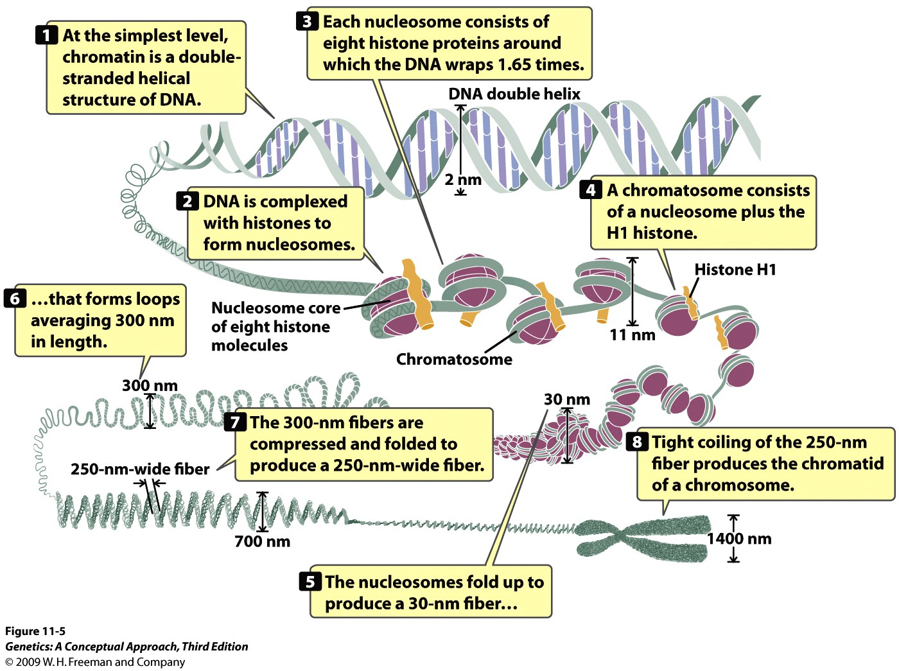

Slide 25
What are Telomeres?
Telomeres are repetitive stretches of DNA located at the ends of linear chromosomes. They protect the ends of chromosomes.
In many types of cells, telomeres lose a bit of their DNA every time a cell divides. Eventually, when all of the telomere DNA is gone, the cell cannot replicate and dies.
White blood cells and other cell types with the capacity to divide very frequently have a special enzyme that prevents their chromosomes from losing their telomeres. Because they retain their telomeres, such as cells generally live longer than other cells.
Telomeres also play a role in cancer. The chromosomes of malignant cells usually cells usually do not lose their telomeres, helping to fuel the uncontrolled growth that makes cancer so devastating.

Slide 26
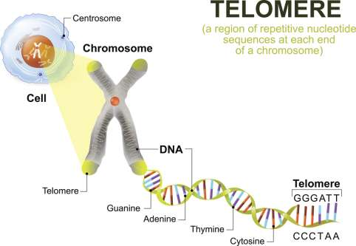

Slide 27
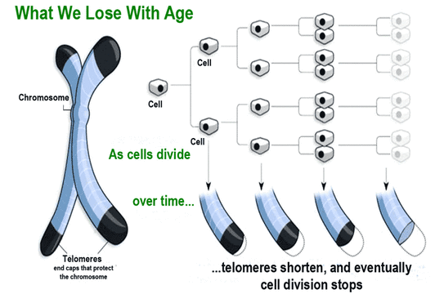

Slide 28


